Slide 1
MAKAAN PROPERTY HOUSE PRICE PREDICTION ANALYSIS
by
Ankita Burde
Under the guidance of
Mr. P. Bose (Top Mentor)

Slide 2
Overview
People and real estate agencies buy or sell properties in order to either live in or as an investment or to run a business. There are multiple factors on which price of a property depends like city, location, size and sometimes the name of the builder can also be a deciding factor. Hence, building a model to predict the price of the property can help the customer as well as company. In this project, we are working on the dataset of the company Makaan.com for house price prediction. Makaan.com has quickly emerged as the preferred partner for consumers looking to rent, buy or sell a home. Makaan.com offers its online consumers maximum property options and has become one of the largest advertising platforms in online real estate in India.
Problem Statement
The company wants us to predict house prices depending on the various aspects with the help of Machine Learning model.

Slide 3
3. Data Description
Table -1 Makaan_Properties_Details(Details about the properties/different features)
Property Name
Property id
Property type
Property status
Price_per_unit_area
Posted On
Project URL
Builder id
Builder name
Property_building_status
City_id
City name
No_of_BHK
Locality_ID
Locality Name
Longitude
Latitude
Price
Size
Sub_urban_ID
Sub_urban_name
description
is furnished
listing_domain_score
is plot
is_RERA_registered
is Apartment
bb) is_ready_to_move
cc) is_commercial_Listing
dd) is_PentaHouse
ee) is studio
ff) Listing Category
Table -2 Makaan_property_location_details
Property_id
City_id
City name
Locality_ID
Locality Name
Longitude
Latitude
Sub_urban_ID
Sub_urban_name

Slide 4
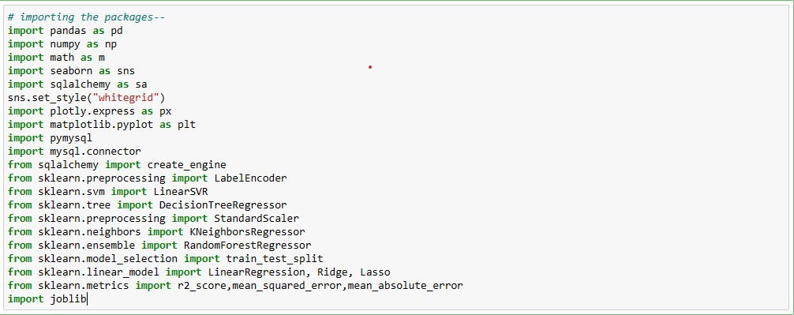
4. Loading the Dataset in Jupyter Notebook

Slide 5
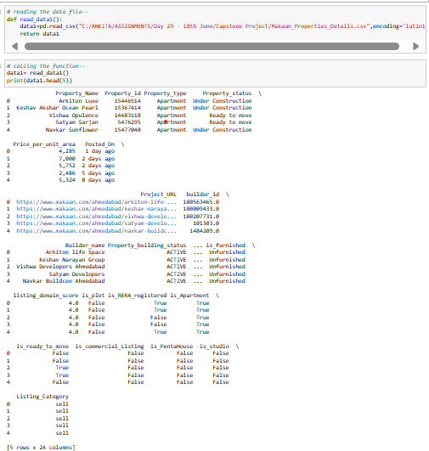
Reading 1st Dataset

Slide 6
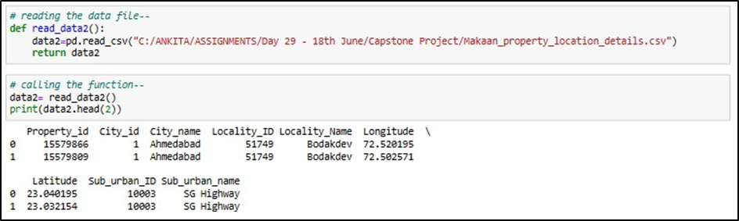
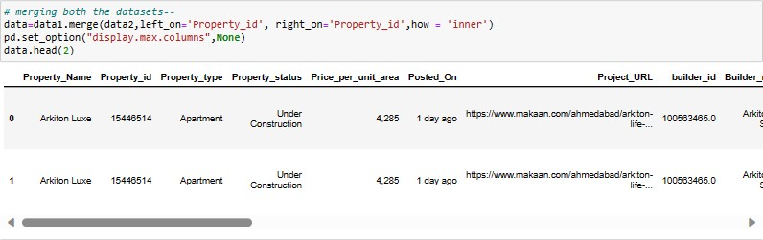
Reading 2nd Dataset
Merging both the Datasets

Slide 7
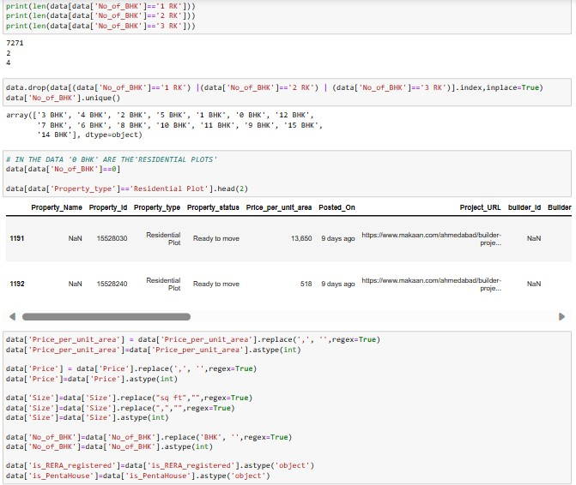
Data Cleaning & Data Type Conversions

Slide 8
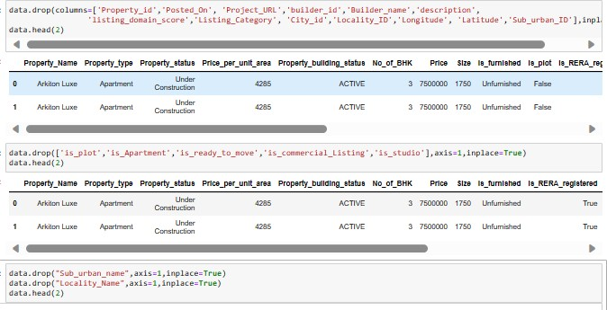
Dropping the columns

Slide 9
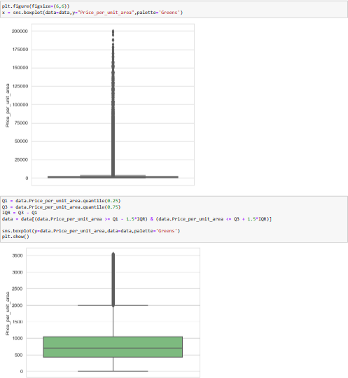
Outlier Treatment

Slide 10
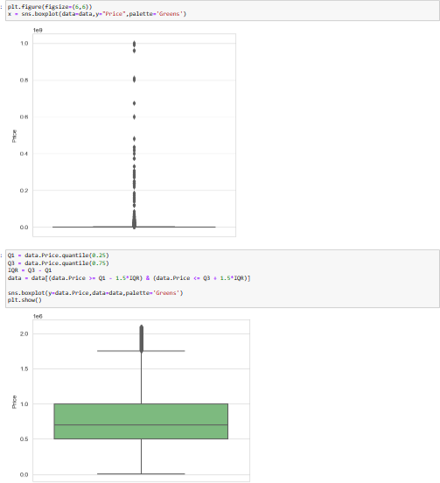

Slide 11
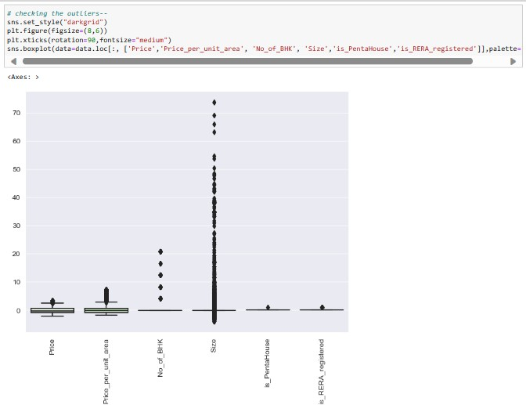
Exploratory Data Analysis

Slide 12
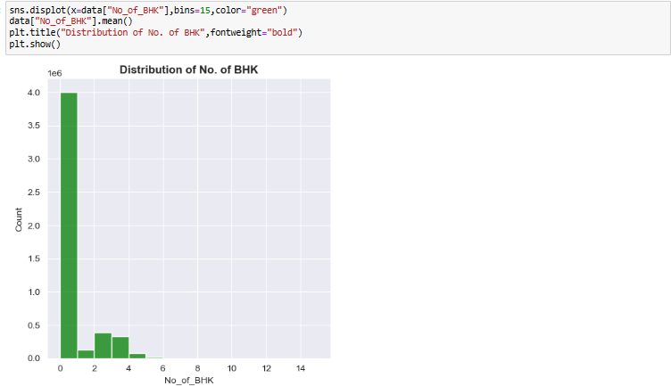
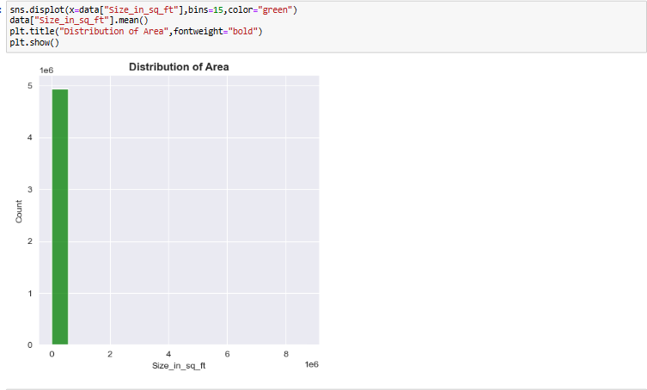
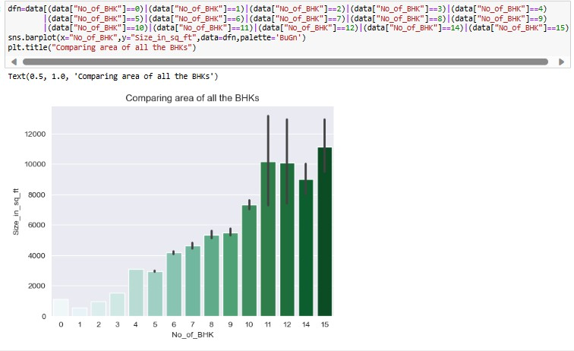

Slide 13
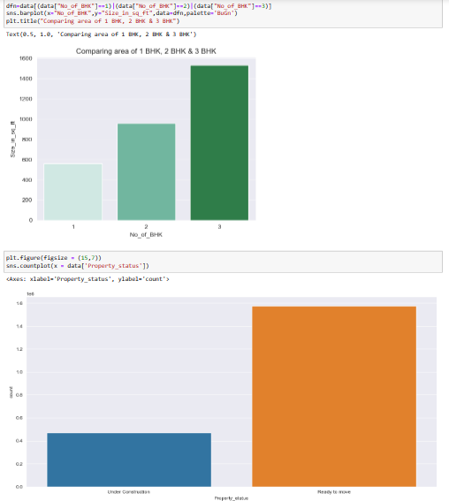

Slide 14
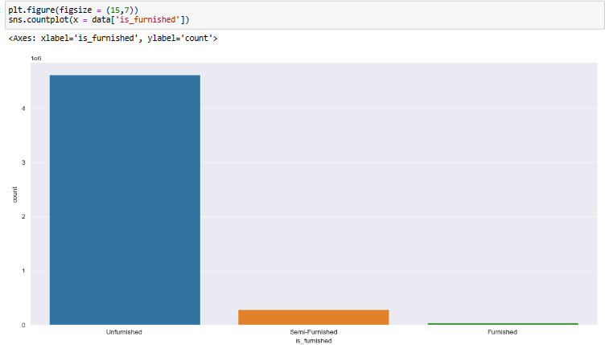
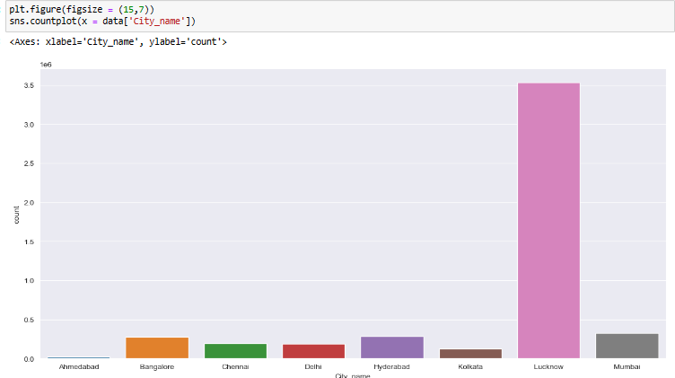

Slide 15
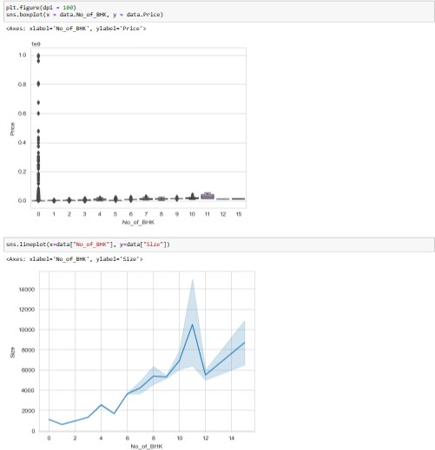
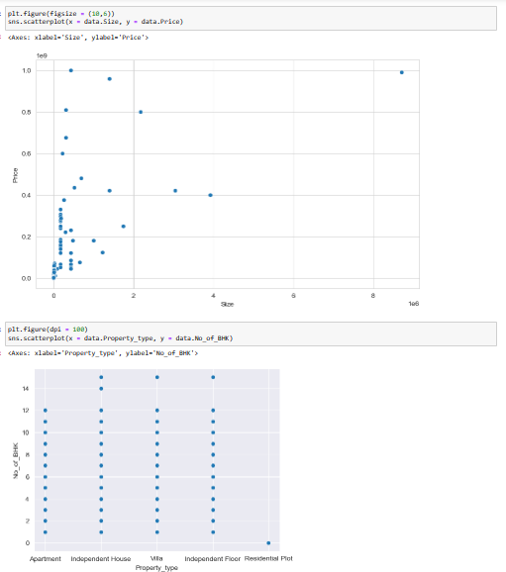

Slide 16
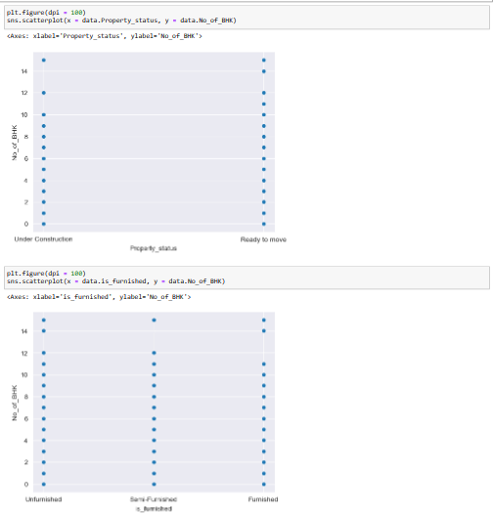
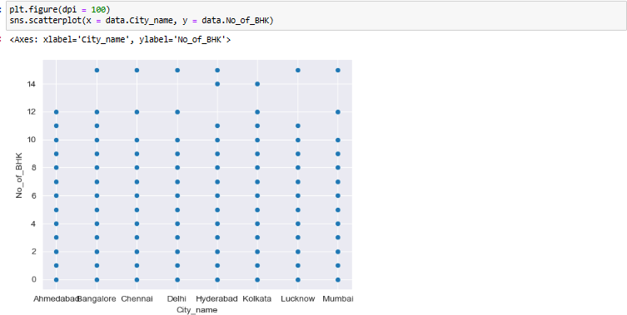

Slide 17
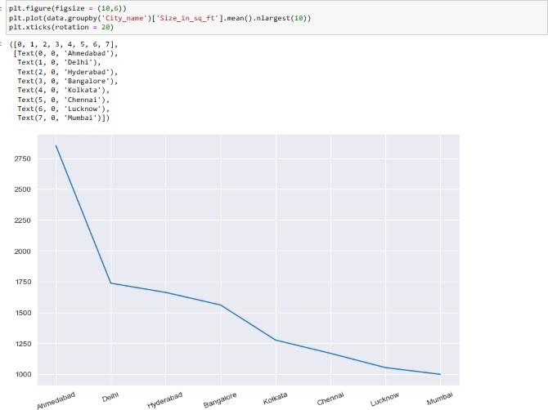
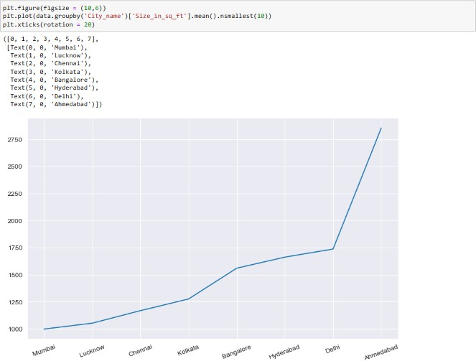
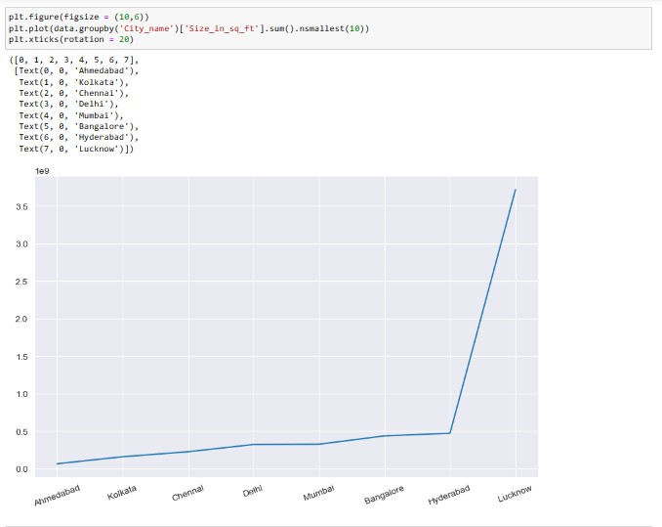
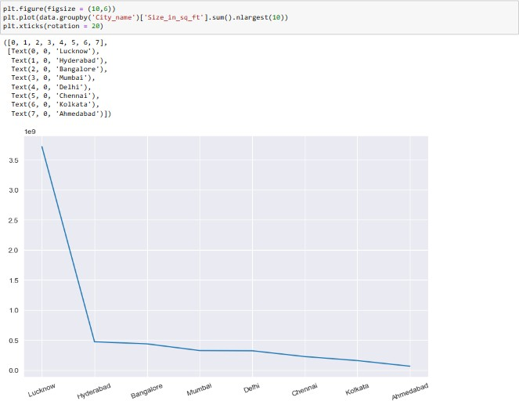

Slide 18
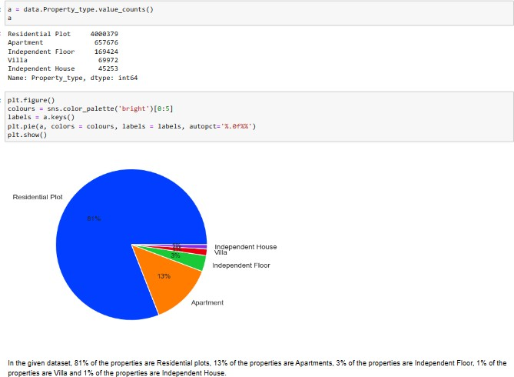
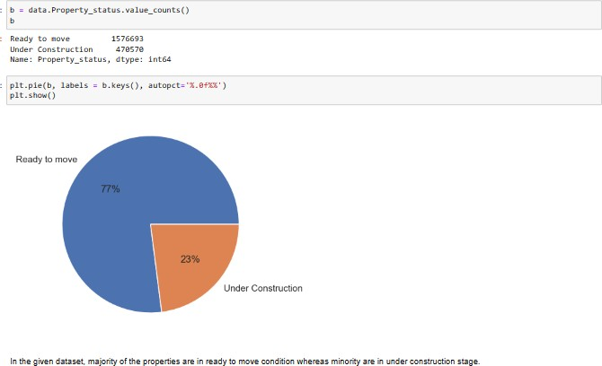

Slide 19
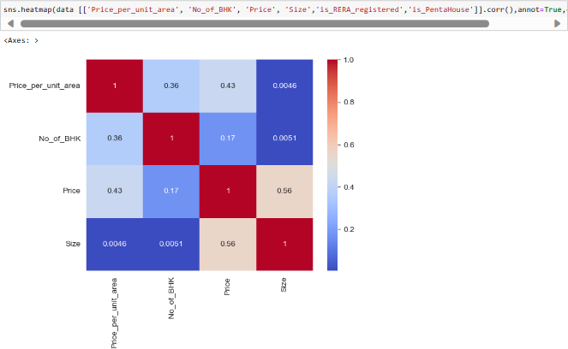
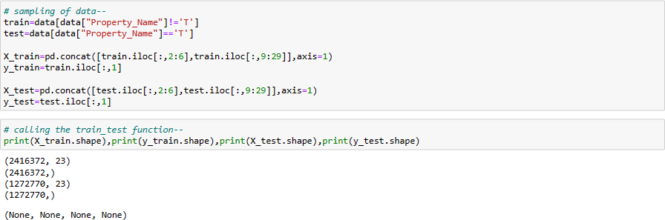

Slide 20
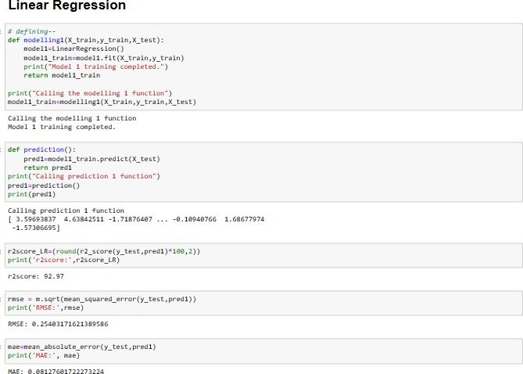
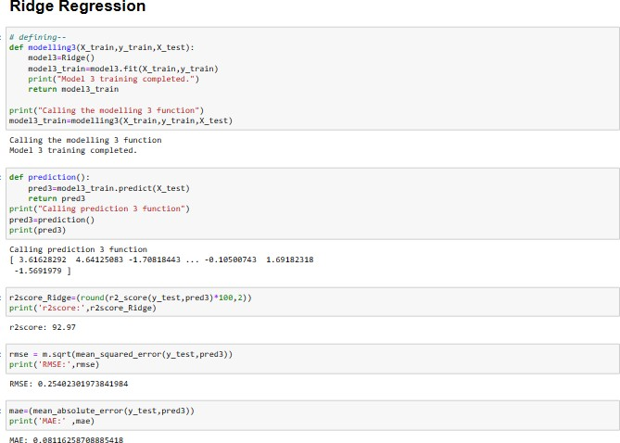

Slide 21
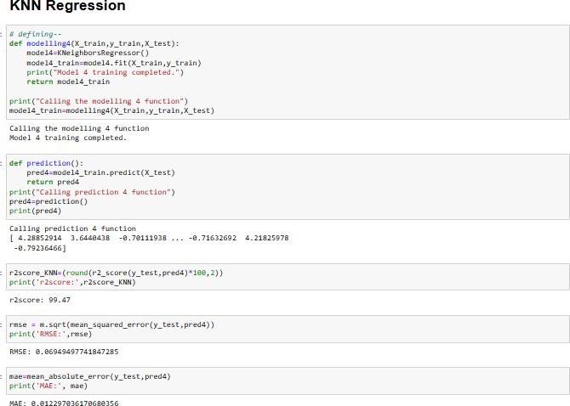
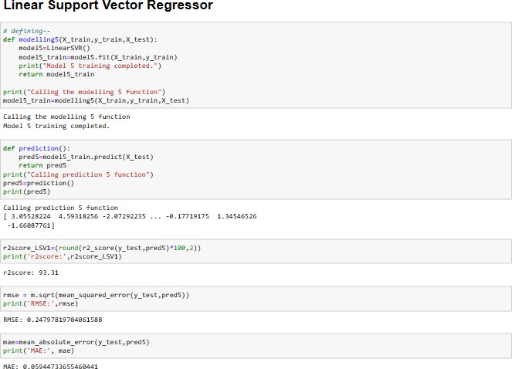

Slide 22
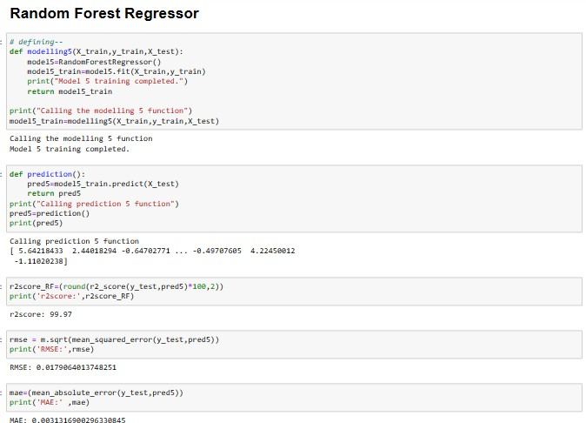
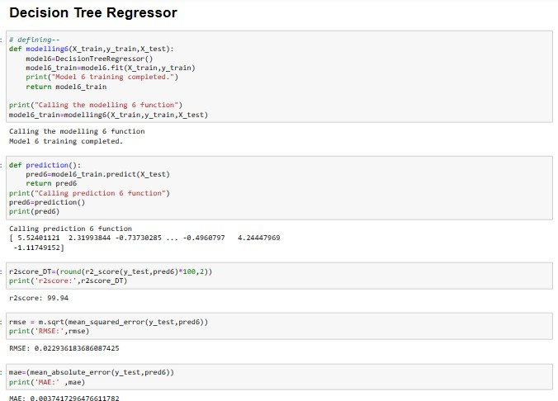

Slide 23
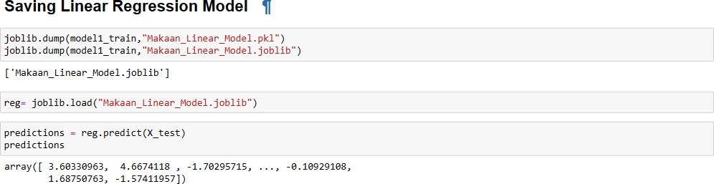
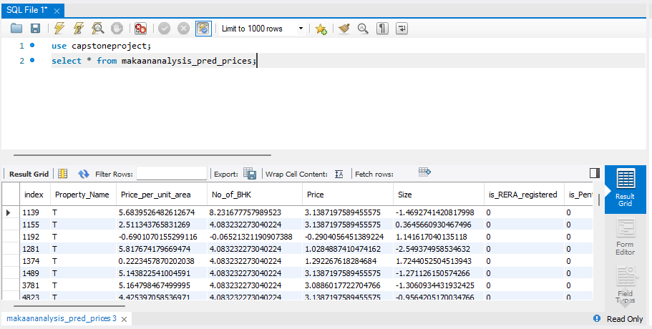
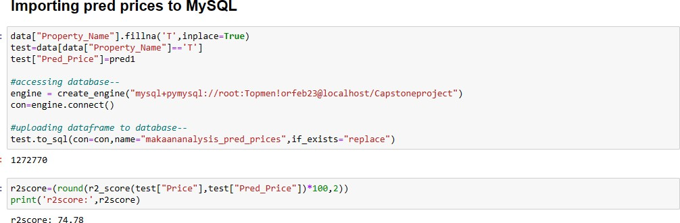

Slide 24
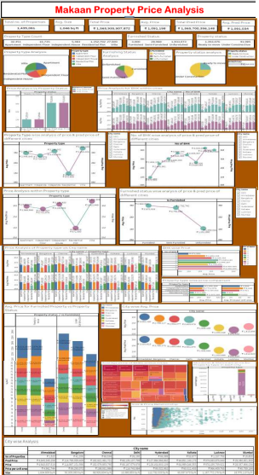
5. Tableau Dashboard

Slide 25
Thank You!

